Slide 1
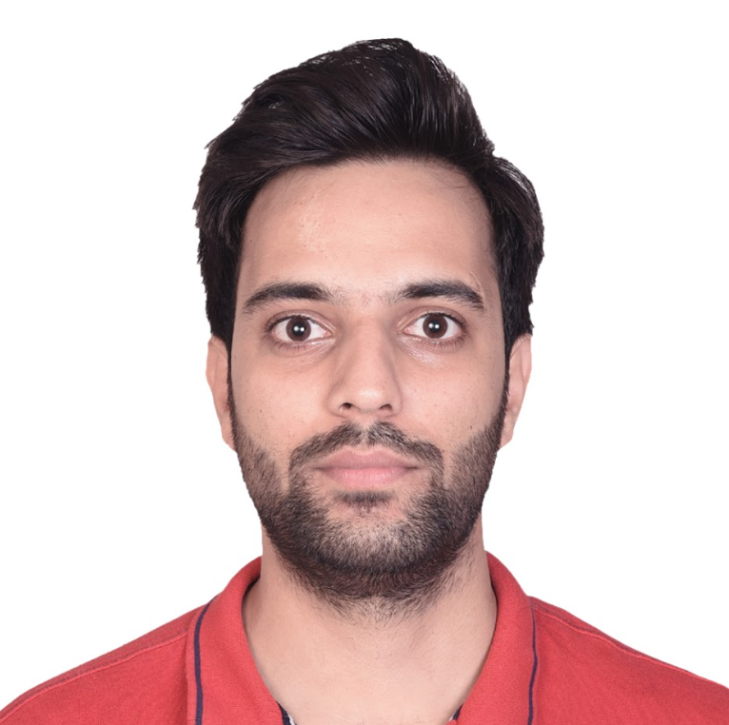
Gitesh Kumar, Development and DevOps(Salesforce, Copado, Flosum)
Professional Summary
Seasoned Salesforce DevOps Leader with more than 4.8 years of industry experience
Proficient in Salesforce Development, encompassing Apex, Lightning Web Components and Salesforce integrations.
Extensive Experience with DevOps practices, particularly using Copado and Flosum for continuous Integration, deployment and release management.
Skilled in version control systems such as Git and continuous integration tools
Proficient in Google SQL and adept at designing and implementing Looker Studio dashboards to facilitate data visualization and analysis
gitesh.kumar@brillio.com
Bangalore India
Industry Experience:
Development, DevOps
Core Skill Sets
Extensive experience in building and managing scalable releases, ensuring timely production releases.
Proficient in the complete lifecycle of CRM applications, including analysis, design, development, customization, and implementation
Experience in working across various Salesforce DevOps tools covering Copado, Flosum, CircleCI
Project Experience
Google LLC: Flosum Implementation and migration
Enhanced Flosum tool to comply with Google Security Standards and its capabilities.
Key responsibilities involve formulating a collaborative strategy among multiple organizations. This includes integrating PMD code checks and implementing continuous monitoring practices, ensuring adherence to Google security standards and onboarding new projects.
Over 30+ production organizations at Google currently utilize the solution.
To analyse data from multiple production organizations, we have created reports outside the Salesforce system using Looker Studio and google proprietary tools.
Google LLC: Consulting and Implementation service related to Salesforce DevOps on Copado
Building and maintaining DevOps process in 100+ Salesforce orgs using Copado.
We were responsible for Streamlining the DevOps process by automation, building pipelines, performing development of quality checks, deployments, managing releases and monitoring orgs.
Strategically planning on how to increase the efficiency and productivity of the system.
Reduced risk and downtime of the system.
Irythm Technologies: Salesforce Classic to lightning migration
We helped iRhythm, upgrading to latest version of Salesforce with new capabilities and by designing a new lightning UI, automating and streamlining their day-to-day processes using lift and shift mechanism.
Developing and deploying new features and solutions to address their business requirements.
UI Processing time improved by 40% and Overall efficiency by 43%.
Certifications
Salesforce Certified Development Lifecycle and Deployment Architect
Salesforce Certified Developer
Salesforce Certified App Builder
Salesforce Certified Administrator
Copado Certified Consultant
Flosum Expert Certified
Recent Roles
Salesforce DevOps Lead
Salesforce Developer
Key Clients​
Google
IRhythm
©2024 Brillio | 1

